Slide 1


Ecommerce Project : Olist Store Analysis

Slide 2
MEET OUR TEAM
Ms. Akshata Nagayi
Ms. Vidya Kalokhe
Ms. Divya Joshi
Mr. Akkena Sridhar
Ms. Ramya Bandigani

Slide 3
INTRODUCTION
By analyzing this dataset, we aim to understand the performance of the olist store, identify trends and extract valuable insights to drive business growth and improve overall efficiency.
The project will involve exploring different aspects of the e-commerce domain, such as customer behavior, sales patterns, product popularity, seller performance and more.
Through this olist Store Analysis project, we hope to uncover valuable insight that can contribute to better decision making, Operational efficiency, Customer Satisfaction.
The finding could potentially guide marketing strategies, inventory management, Sellers onboarding & other crucial aspect of the ecommerce business.

Slide 4
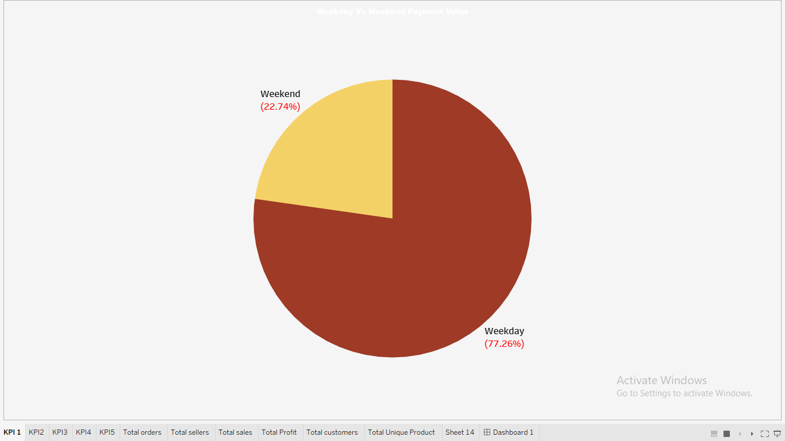
KPI-1 Weekday Vs Weekend Payment Statistics
The sum of payment in the weekdays is 77.26 % while for weekend its 22.74%
The majority of transactions occur on weekdays, highlighting higher payment activity during the workweek. This trend suggests that weekdays are the primary period for customer purchases. To balance the distribution, consider strategies to boost weekend engagement, such as targeted promotions or special weekend offers.

Slide 5
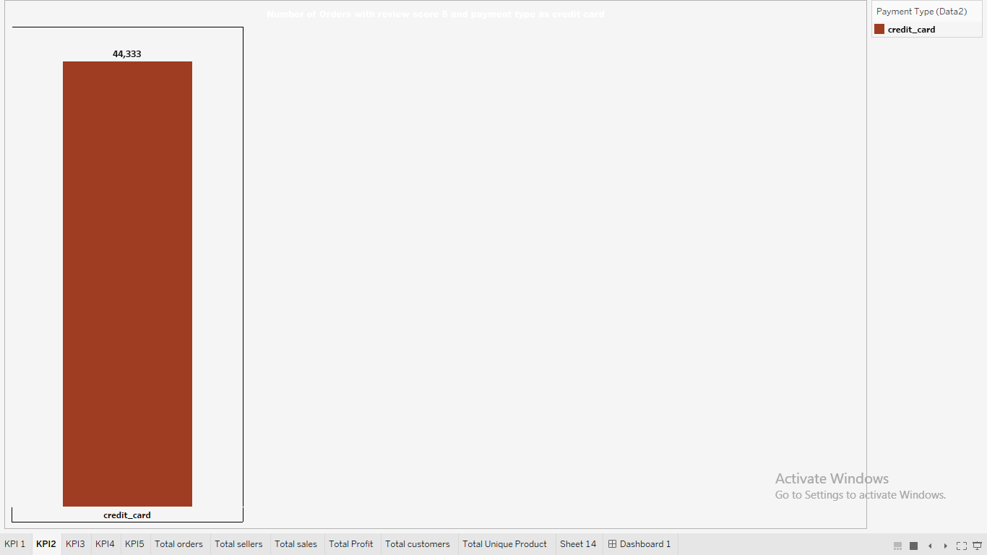
KPI – 2 Number of Orders with review score 5 and payment type as credit card
This KPI shows that 44,333 orders received the highest review score of 5 and were paid using a credit card.
This indicates a strong correlation between high customer satisfaction and the use of credit cards for payment.
It highlights the importance of credit card transactions in driving positive customer feedback and could inform future payment and satisfaction strategies.

Slide 6
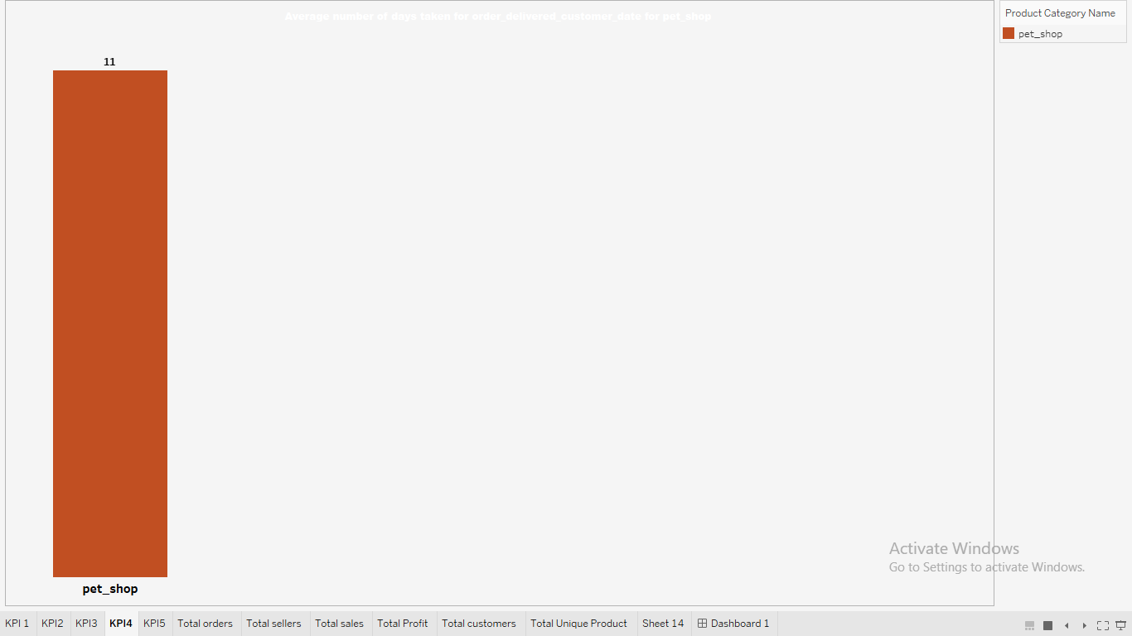
KPI -3 Average number of days taken for order delivered customer date for pet shop
On average, it takes 11 days for orders from the pet shop to be delivered to customers.
This timeframe can be used as a benchmark for evaluating delivery performance.
If the goal is to improve customer satisfaction, reducing this delivery time might be a key focus area, possibly by optimizing logistics and supply chain processes.

Slide 7
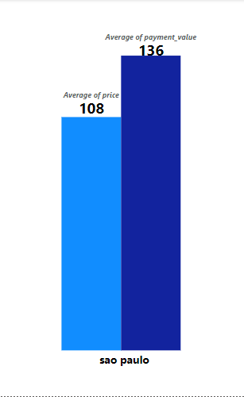
KPI-4 Average price and payment values from customers of São Paulo city
The average order price for customers in São Paulo is 108, but the average payment received is 136.
This indicates that customers are likely paying more than the initial price, possibly due to additional services, fees, or installment options.
Understanding this trend can help optimize pricing strategies and offer targeted promotions that align with customer payment behaviors, ultimately boosting revenue.

Slide 8
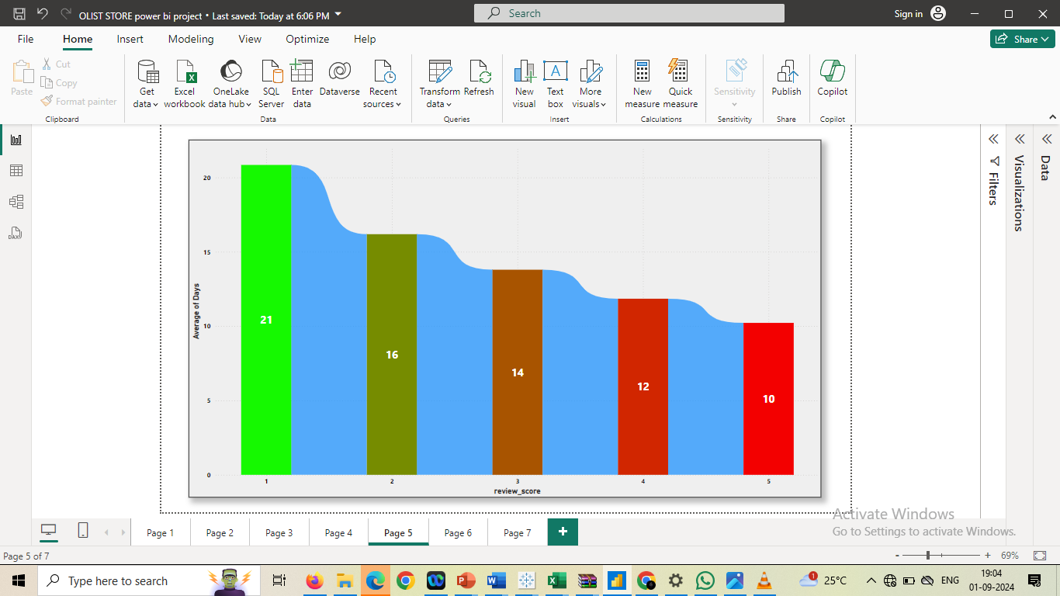
KPI-5 Relationship between shipping days vs review scores
This KPI shows a clear trend: as shipping times decrease, customer review scores improve.
Orders with a review score of 1 take an average of 21 days to be delivered, while orders with a perfect score of 5 are delivered in just 10 days on average.
This suggests that faster shipping is directly linked to higher customer satisfaction. Focusing on reducing delivery times could lead to better reviews and improved customer loyalty.

Slide 9
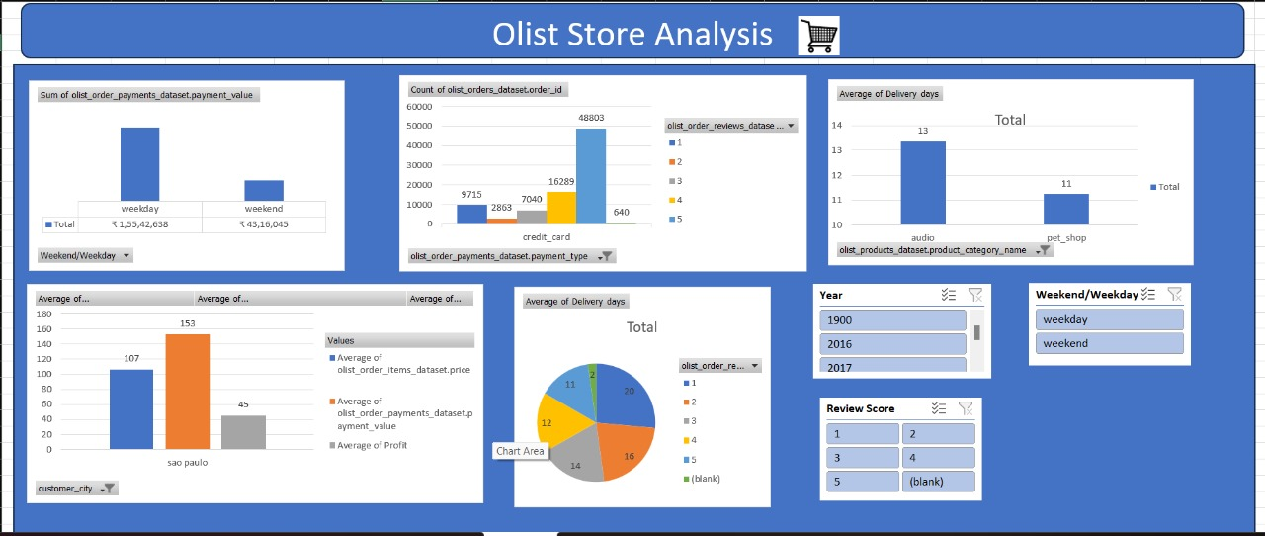
Excel Dashboard

Slide 10
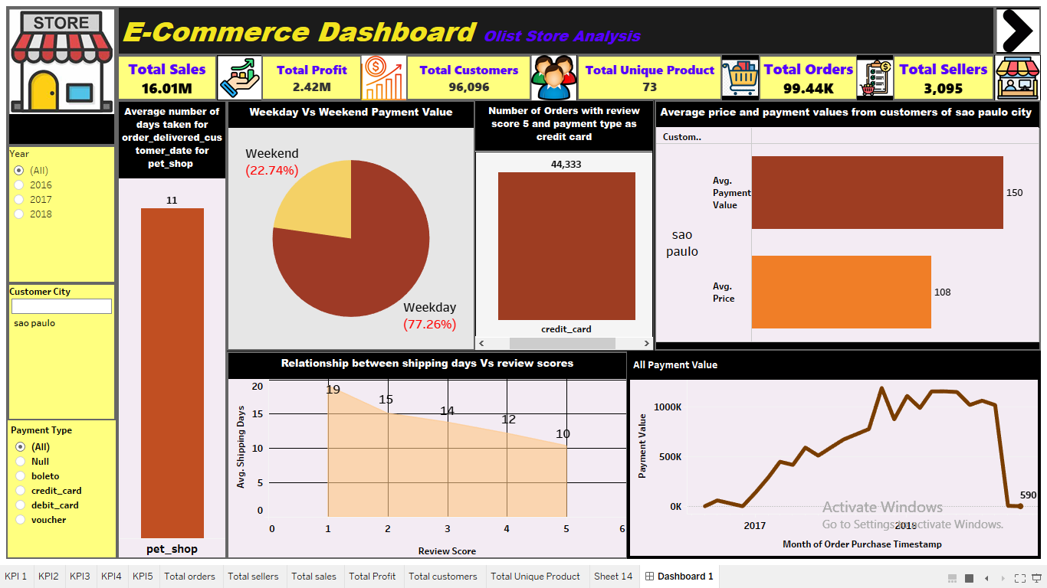
Tableau Dashboard

Slide 11
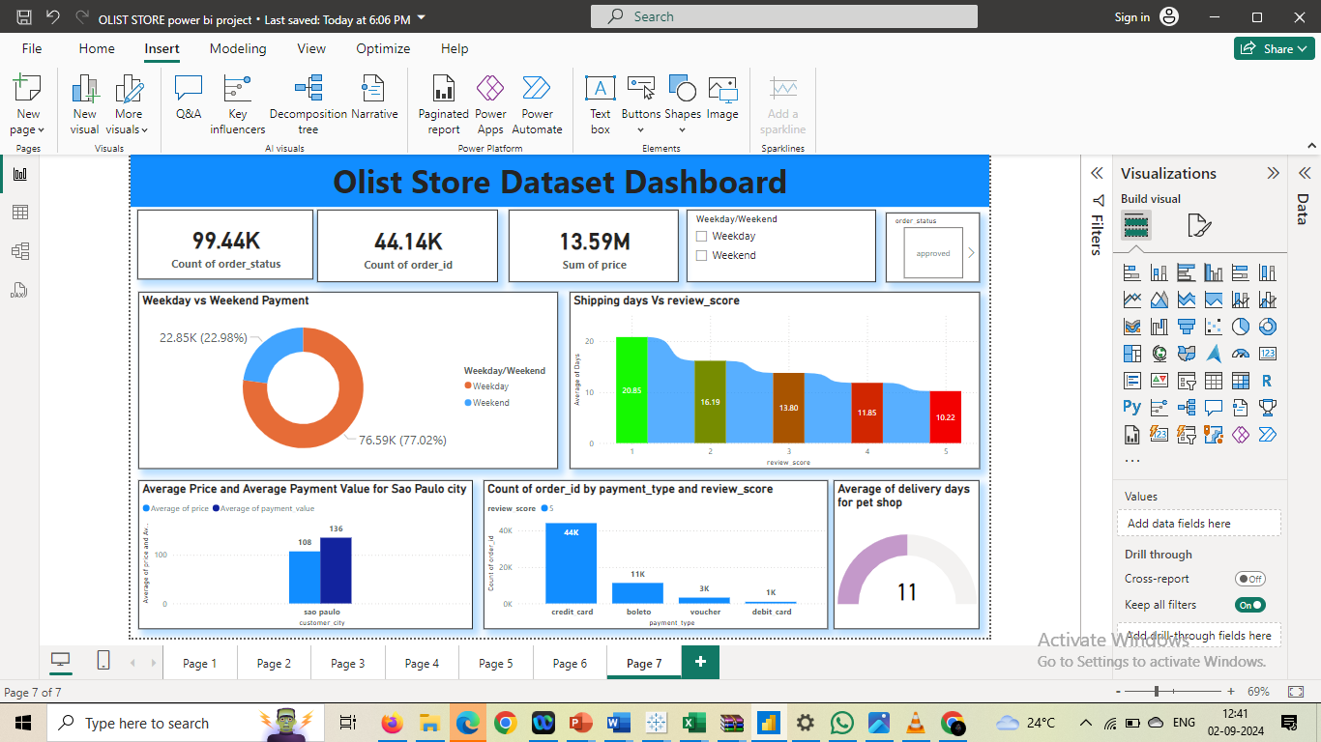
Power BI Dashboard

Slide 12
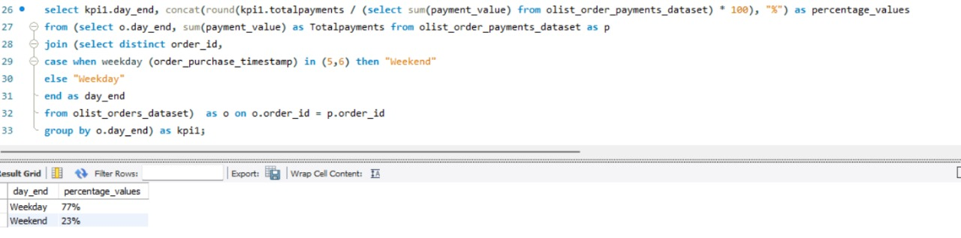
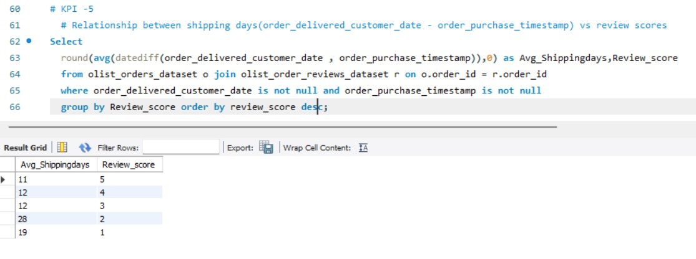
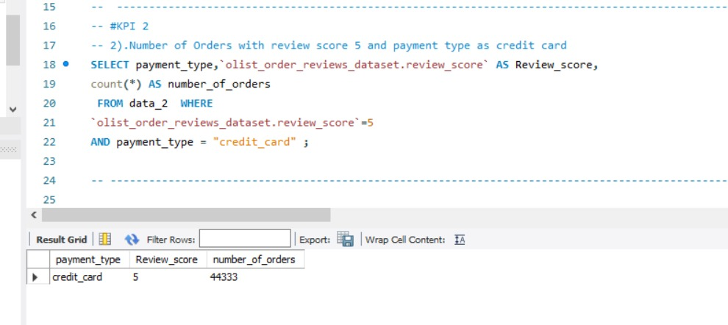
SQL Query

Slide 13
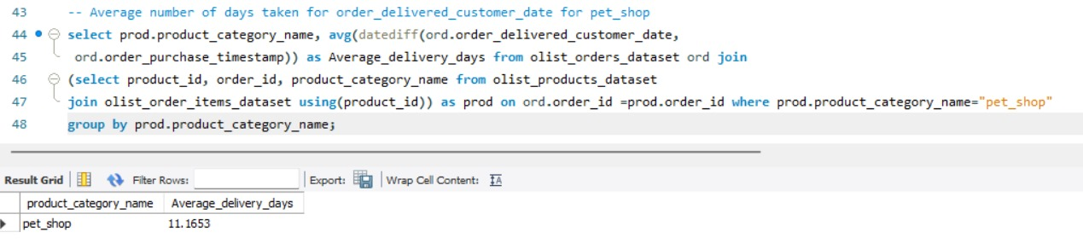
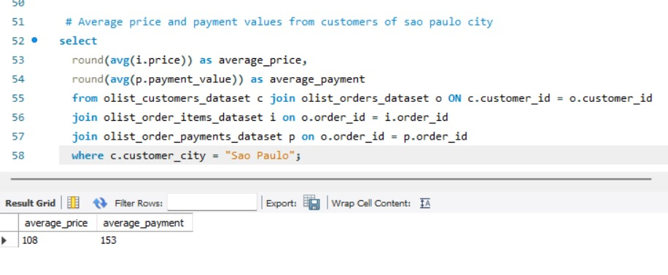

Slide 14
RECOMMENDATION
Enhance Shipping Efficiency : Prioritize reducing delivery times to boost customer satisfaction and drive better review scores. Explore faster logistics solutions or partnerships to improve delivery performance.
Focus on Weekday Promotions : Maximize sales by targeting promotions and marketing efforts on weekdays, when the majority of payments are made. Leverage this peak activity to increase engagement and conversions.
Strengthen Credit Card Loyalty Programs : Develop loyalty programs or exclusive offers for credit card users, who are more likely to leave positive reviews. This can help foster customer loyalty and encourage repeat business.
Refine Regional Pricing Strategies : In regions like São Paulo, where customers tend to pay more than the average order price, consider offering tailored pricing, upsell opportunities, and premium services to capitalize on their higher spending behavior.
Monitor and Improve Customer Experience : Continuously track the relationship between shipping times and review scores, adjusting strategies as needed to maintain high levels of customer satisfaction.

Slide 15
CHALLENGES
In this project, we encountered challenges such as dealing with data quality issues, including missing and inconsistent entries, which required thorough cleaning and preprocessing.
Additionally, managing and analyzing a large dataset posed performance challenges.
Balancing key metrics like sales performance and customer satisfaction, while ensuring clear and impactful visualizations, also proved difficult.
Lastly, managing time effectively while refining the analysis and meeting deadlines was a continuous challenge.

Slide 16
CONCLUSION
The analysis highlights key opportunities for improving customer satisfaction and driving business growth.
By optimizing shipping times, businesses can enhance customer experiences and secure better reviews.
Targeted weekday promotions and strengthened credit card loyalty programs can boost sales and retention.
Additionally, refining regional pricing strategies, particularly in high-value markets like São Paulo, will help capitalize on customer spending habits.
These insights provide a clear roadmap for improving overall performance and ensuring long-term success.

Slide 17


